Slide 1
Defining the 4th "90": Quality of life – The role of community in determining outcomes and person-centred interventions
Summary from Main Conference Workshop
Kevin Moody, BScPhm, MBA, EdD
AIDS 2018 26 July 2018

Slide 2
Agenda from Main Conference Workshop
Opening remarks and Chair
Stephen Doughty, MP, UK
Context: What is quality of life?
Kevin Moody, The Netherlands
Innovative approaches to person-centred care
Maryan Said, Norway
Non-health-related quality of life
Visvanathan Arumugam, India
Key Populations
Flavian Rhode, South Africa
Measurement
Paula Munderi, Uganda

Slide 3
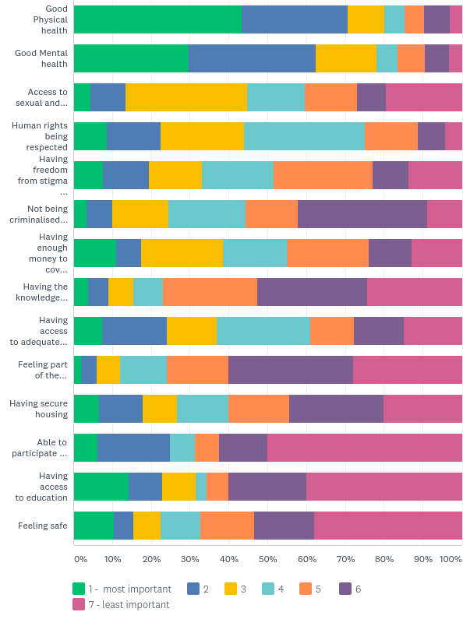

Slide 4
The 4th ‘90’ – Quality of Life
Beyond viral suppression – Lazarus et al.¹
HIV Outcomes: Beyond viral suppression²
https://bmcmedicine.biomedcentral.com/articles/10.1186/s12916-016-0640-4
http://hivoutcomes.eu

Slide 5
Barriers to implementation
Past experience with GIPA is mixed and often not meaningful
Systems in place are currently organized in silos
Approaches are system-, provider- or service-oriented
Treating health is seen as treating a defect
Public health versus personalised care

Slide 6
Beyond?
For people whose virus is suppressed, it’s important to look at their health and wellness beyond undetectability
For others, quality of life measures need to be in place as a prerequisite to enter or stay in the continuum of care

Slide 7
Knowledge, Will and Power
Knowledge
Will
Power

Slide 8
Highlights: Innovative approaches to person-centred care
Barriers:
Stigma, Power, Inclusion
Opportunities:
Use data effectively, train health providers, build on differentiated care
Advocacy messages
Client first: Dialogue and collaboration
Client, communities, service providers, policy makers

Slide 9
Highlights: Non-health-related QoL
Most important issue
Needs priorities differ
Food versus medicines versus ageing
Relation to 90-90-90:
Decriminalisation
Need to be country-specific
Advocacy messages
Evidenced-based research on social, in addition to biomedical approaches

Slide 10
Highlights: Key populations
Major challenges
Laws! Quality of services! Stigma!
Structural issues versus health and non-health related quality of life
Difficult to prioritise QoL when key populations are illegal
Need to act based on evidence (that rarely exists) and address parallel systems.
Advocacy messages
Quality of life is not the 4th 90. It is the glue that ties the 90-90-90 together.

Slide 11
Highlights: Measurement
Major challenges
QoL is not linear.
Children and young adolescents – how do we measure?
Are snapshot checklists enough?
Are we measuring the journey or the destination?
Advocacy messages
How to define and relate the added value for the individual and the added value for service provision to show it’s worth investing in.

Slide 12
THANK YOU!
Kevin Moody
k@kevinmoody.org

